Slide 1


Data Preprocessing
Gabriel Avelino Sampedro, Ph.D.
Chairman, Korean Institute of Communications and Information Sciences - PH Section
Founder / CEO, Philippine Coding Camp

Slide 2
DATA CLEANING
Raw data is inherently dirty. Some issues may include:
    Spelling/encoding errors
    Incorrect data types
    Non-ideal formats
    Missing values
In data cleaning, these inconsistencies are addressed to prevent problems in analysis.

Slide 3
DATA CLEANING
Raw data is inherently dirty. Some issues may include:
    Spelling/encoding errors
    Incorrect data types
    Non-ideal formats
    Missing values
In data cleaning, these inconsistencies are addressed to prevent problems in analysis.

Slide 4
DATA CLEANING
Noisy Data

Slide 5
DATA CLEANING

Slide 6
DATA CLEANING

Slide 7
DATA CLEANING

Slide 8
DATA CLEANING

Slide 9






DATA CLEANING
Separate
Files
Multiple
Representations
Incorrect
Datatype
Default
Values
Inconsistent Format
Missing Data
Duplicate Data

Slide 10
DATA CLEANING
Separate Files
Data comes from multiple sources.
    Collected at different times
    Completely different datasets
Use various pandas functions such as concat() and merge() to combine separate files.

Slide 11
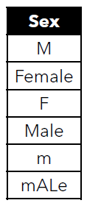
DATA CLEANING
Multiple Representations
    Different representations of text may occur in the dataset.
    Use the unique() function to ensure that categorical variables are correctly represented.

Slide 12
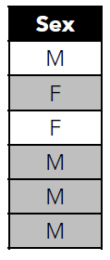
DATA CLEANING
Multiple Representations
    Modify the values by assigning the same value for each categorical level.
    The map() function of pandas might be useful for this problem.

Slide 13
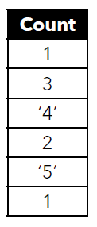
DATA CLEANING
Incorrect Datatype
    Numerical values in the dataset may be represented as text or string.
    Use the info() function to check the datatype of each column in the dataset.

Slide 14
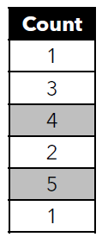
DATA CLEANING
Incorrect Datatype
    Convert all variables to their appropriate numerical data type.
    Use the apply() function to the appropriate column and use a lambda function to convert each element to a numerical data type.

Slide 15
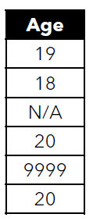
DATA CLEANING
Default Values
    Datasets may use a default value for when the data is missing or not applicable.
    Handle these cases appropriately depending on the context.
    In pandas, missing values are represented as NaN or None.

Slide 16
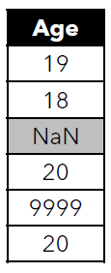
DATA CLEANING
Default Values
    Make sure that all missing values are represented as None or NaN.
    For other kinds of default values, handle them depending on the context.

Slide 17
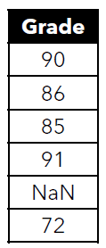
DATA CLEANING
Missing Data
    Elements in the dataset may be missing because the data is unavailable.
    Missing values are represented as NaN or None in pandas.

Slide 18
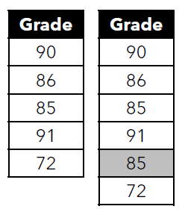
DATA CLEANING
Missing Data
Handling missing data depends on the domain. Use your own judgment.
    Option: Delete all rows that contain missing data.
    Option: Replace the missing data with the mean of the variable
    And other schemes…

Slide 19
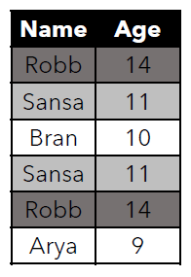
DATA CLEANING
Duplicate Data
A dataset may contain duplicate data.
    In some cases, there really is a duplicate.
    In some cases, it may be caused by an error.

Slide 20
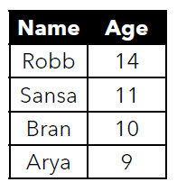
DATA CLEANING
Duplicate Data
If there are duplicate rows, consider removing them from the dataset.
    •It depends whether this is caused by an error or really part of the dataset.
    •Use the drop_duplicates() function to delete duplicates in the dataset.

Slide 21
DATA CLEANING

Slide 22
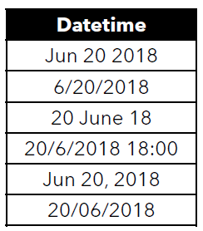
DATA CLEANING
Inconsistent Format
Date and time may be recorded in inconsistent formats
      •Human error
      •Inconsistencies in data collection and encoding
      •Different locale and formats

Slide 23
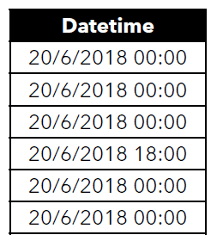
DATA CLEANING
Inconsistent Format
Date and time may be recorded in inconsistent formats
      •Human error
      •Inconsistencies in data collection and encoding
      •Different locale and formats

Slide 24
DATA PREPROCESSING

Slide 25
DATA PREPROCESSING
Querying
Imputation
Binning
Outlier Detection
One Hot Encoding
Log Transformation
Aggregation
Column Transformation
Feature Scaling
Feature Engineering

Slide 26
DATA PREPROCESSING
Querying
Use the query() function of pandas to write complex conditions for selecting appropriate info from the dataset.
The query() function queries the columns of a DataFrame with a Boolean expression.
This function provides a more streamlined syntax for getting a subset of the DataFrame.

Slide 27
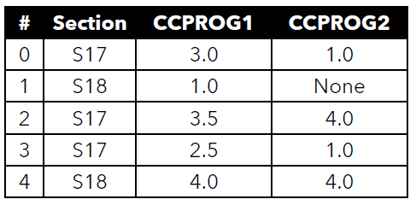
DATA PREPROCESSING
Querying
Ex1. Select rows based on numerical value
df.query(‘CCPROG1 >= 3.5’)

Slide 28
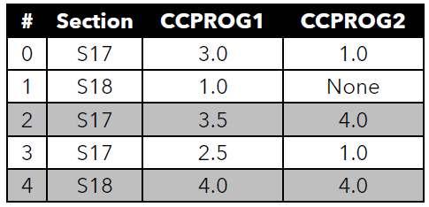
DATA PREPROCESSING
Querying
Ex1. Select rows based on numerical value
df.query(‘CCPROG1 >= 3.5’)

Slide 29
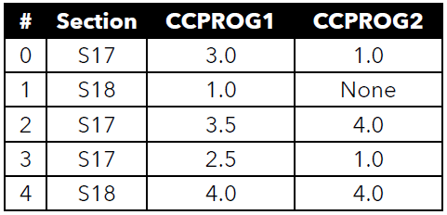
DATA PREPROCESSING
Querying
Ex2. Select rows based on string value
df.query(‘SECTION == “S17”’)

Slide 30
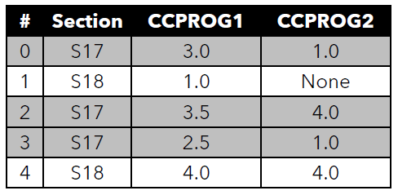
DATA PREPROCESSING
Querying
Ex2. Select rows based on string value
df.query(‘SECTION == “S17”’)

Slide 31
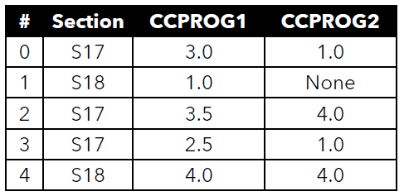
DATA PREPROCESSING
Querying
Ex3. Select rows based on multiple conditions
df.query(‘CCPROG1 >= 3.0 and Section == “S17”’)

Slide 32
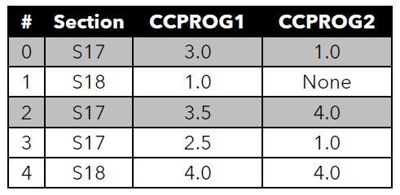
DATA PREPROCESSING
Querying
Ex3. Select rows based on multiple conditions
df.query(‘CCPROG1 >= 3.0 and Section == “S17”’)

Slide 33
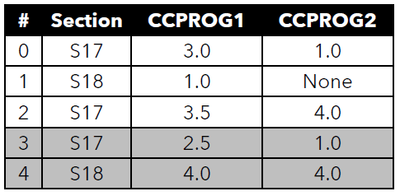
DATA PREPROCESSING
Querying
Ex4. Select rows based on index
df.query(‘index > 2’)

Slide 34
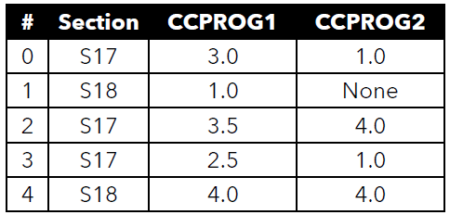
DATA PREPROCESSING
Querying
Ex5. Select rows by comparing multiple columns
df.query(‘CCPROG1 > CCPROG2’)

Slide 35
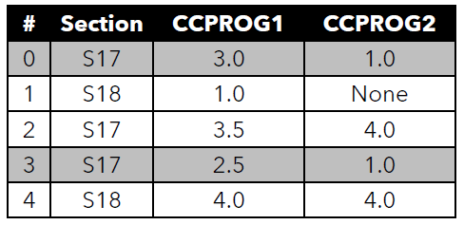
DATA PREPROCESSING
Querying
Ex5. Select rows by comparing multiple columns
df.query(‘CCPROG1 > CCPROG2’)

Slide 36
DATA PREPROCESSING
Looping
Use iterrows() to iterate over all rows and apply some operation over each row.
  for cur_idx, cur_row in df.iterrows():
  # perform some operations
In this example, cur_idx is the index of the current row and cur_row is the actual row.

Slide 37
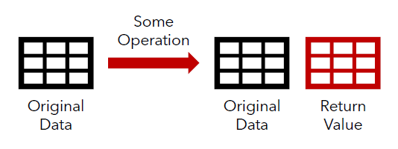
DATA PREPROCESSING
In place parameter
inplace=False

Slide 38
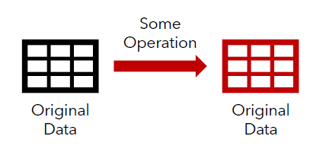
DATA PREPROCESSING
In place parameter
inplace=True

Slide 39
DATA PREPROCESSING
Imputation
Datasets with missing values could be a result of:
    Error in the data collection process
    Privacy/refusal to give information
    Interruptions/failure in sensors
Rows with missing values might be dropped from the dataset. However, this might not be the best approach in all cases.

Slide 40
DATA PREPROCESSING
Imputation
Use a threshold value to decide whether to drop or not.
Drop columns with missing value less than the threshold t:
df = df[df.columns[df.isnull().mean() < t]]
Drop rows with missing value less than the threshold t:
df = df.loc[df.isnull().mean(axis=1) < t]]

Slide 41
DATA PREPROCESSING
Imputation
Another approach is called imputation, where missing values are estimated based on existing values.
There are two types of imputations – numerical imputation and categorical imputation

Slide 42
DATA PREPROCESSING
Imputation
In numerical imputation, use the median or average of the other values as an estimate of the missing values.
For example, the age of one person is missing. Then, just use the median age of all other people in the dataset to estimate the age of that person – the missing age is likely the same as the most common age in the dataset.
Note: Check the dataset whether this is a good idea or not.

Slide 43
DATA PREPROCESSING
Imputation
In categorical imputation, use the mode as the estimate for the missing values.
For example, a person’s smoking information is missing. However, 95% of the people in the dataset are non-smokers. Assume that the missing value is “non-smoker.”
Note: This might not be the best approach if there is no dominant value in the dataset, and the values are approximately uniformly distributed.

Slide 44
DATA PREPROCESSING
Binning
Binning refers to a technique where data is grouped together into a series of categories.
There are two types of binning – binning numerical data and binning categorical data

Slide 45
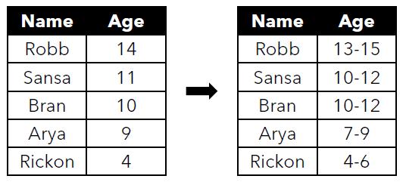
DATA PREPROCESSING
Binning
Numerical data are grouped in different ranges of values.

Slide 46
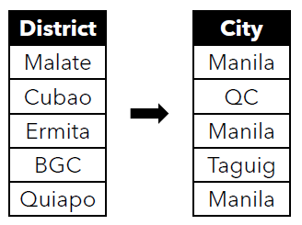
DATA PREPROCESSING
Binning
Categorical data are grouped by related values.

Slide 47
DATA PREPROCESSING
Binning
Binning is useful in cases wherein the dataset is too specific for the research questions.
It could reveal relationships and insights in a clearer way that could not easily be seen if the original values were used.
In machine learning, binning helps prevent overfitting, where models are tailor-fitted to specific examples instead of being able to recognize general cases.

Slide 48
DATA PREPROCESSING
Outlier Detection
Outliers are extreme values in the dataset. These might be detection using different approaches:
      Visualization techniques
      Standard deviation/Z-score
      Percentiles

Slide 49
DATA PREPROCESSING
Outlier Detection
Detect outliers by plotting data points in a graph

Slide 50
DATA PREPROCESSING
Outlier Detection
Use a more quantitative approach by measuring the z-score, or the number of standard deviations from the mean of each data point.
If our data is nearly normal, then anything outside 3 standard deviations from the mean is an outlier.

Slide 51
DATA PREPROCESSING
Outlier Detection
Detect outliers by plotting data points in a graph
Get the middle 𝑥 percent of the data. Anything outside the
middle 𝑥 percent is an outlier.

Slide 52
DATA PREPROCESSING
Outlier Detection
Drop – Remove the rows with outliers to exclude them from analysis since these might be extreme cases that do not happen normally.
Use a cap – Instead of reducing data size, simply clamp the values within the desired range. This can help prevent adverse effects on algorithms and models that are sensitive to outliers but may affect the actual distribution of the data.

Slide 53
DATA PREPROCESSING
Outlier Detection
  Consideration:
      There are many causes of outliers, from errors in encoding to real rare occurrences in the dataset.
      By removing or disregarding them, some important insights might be removed from our data.
      Thus, be careful in handling outliers.

Slide 54
DATA PREPROCESSING
One Hot Encoding
    Some data modelling techniques, including machine learning algorithms, require different data representation.
    In the Boolean representation, each property is represented as a column where the value is 1 if it is true and 0 otherwise.
    For example, in content-based recommender systems, the item profile was represented as a Boolean vector.

Slide 55
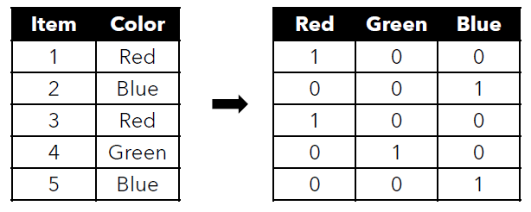
DATA PREPROCESSING
One Hot Encoding
Sometimes, data must be represented in this format.

Slide 56
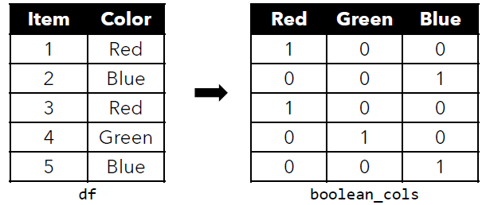
DATA PREPROCESSING
One Hot Encoding
boolean_cols = pd.get_dummies(df[‘Color’])

Slide 57
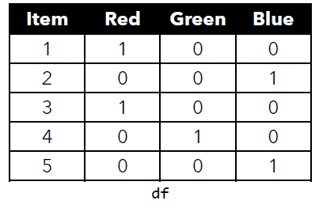
DATA PREPROCESSING
One Hot Encoding
df = df.join(boolean_cols).drop(‘Color’, axis=1)

Slide 58
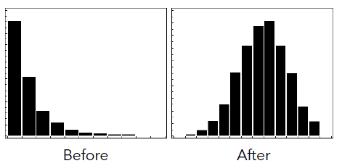
DATA PREPROCESSING
Log Transformation
Log transformation may be applied on non-normal data to make them more normally distributed.

Slide 59
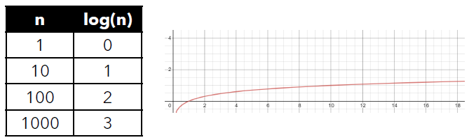
DATA PREPROCESSING
Log Transformation
  The log operation log(𝑛) evaluates to 𝑥, where 10𝑥 = 𝑛
  Note that relationship between 𝑛 and log(𝑛).

Slide 60
DATA PREPROCESSING
Log Transformation
  By applying the log function to every data point, the values are transformed by reducing the effect of extremely high values while preserving the order.
  Note: The order of the data points are preserved in log transformation, but the scale of the distances between each data point might be distorted.

Slide 61
DATA PREPROCESSING
Aggregation
  Apply aggregation to summarize data.
  Aggregation is generally performed when we have several rows that belong to the same group or same instance.
  There are two types of aggregation – aggregating numerical data and aggregating categorical data

Slide 62
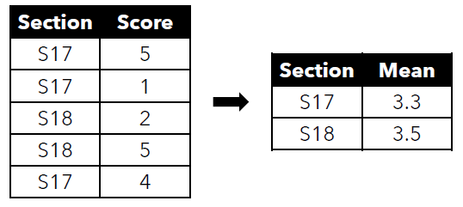
DATA PREPROCESSING
Aggregation
Sum or mean might be extracted from numerical data.

Slide 63
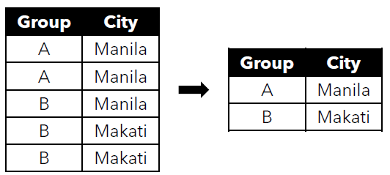
DATA PREPROCESSING
Aggregation
Mode within a group can be used for categorical data.

Slide 64
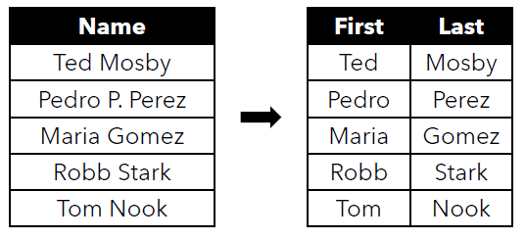
DATA PREPROCESSING
Column Transformation
Transform columns to extract better info from the dataset.

Slide 65
DATA PREPROCESSING
Column Transformation
Transform dates into better representations since computers cannot understand order given dates such as “2019-06-04”.
  Extract the month, day, and year, and put them in separate columns as numerical values.
  Use a single numerical representation for each date (e.g., the number of seconds since a constant date).

Slide 66
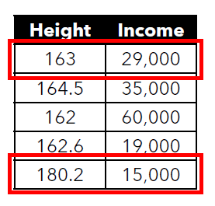
DATA PREPROCESSING
Feature Scaling
Different variables may have different ranges.
Some algorithms will be affected if one variable “overpowers” others.
Example, Euclidean distance will be affected if the scale of the variables are not equal

Slide 67
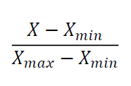
DATA PREPROCESSING
Feature Scaling
Normalization scales all features into a
range of 0 to 1.
Note: This is susceptible to outliers.

Slide 68
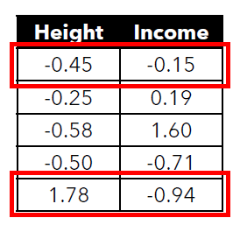
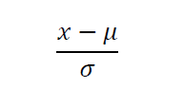
DATA PREPROCESSING
Feature Scaling
Standardization (z-score) measures the
distance of each point from the mean.
Note: Less susceptible to outliers, since
it considers the standard deviation.

Slide 69
DATA PREPROCESSING
Feature Engineering
Feature engineering refers to the use of domain knowledge to extract new features from data.
This can help generate better insights and improve performance of machine learning algorithms.

Slide 70
DATA PREPROCESSING
Feature Engineering
Examples
  From the height and weight, extract the body mass index
  From the date, determine whether it is a holiday or not.
  From the location, determine the nearest hospital/school/etc.
  From the geo-coordinates (latitude), estimate the climate.

Slide 71
Thank you for listening!
Let’s Connect:
Gabriel Avelino Sampedro, Ph.D.
garsampedro@ieee.org
WhatsApp: +63 999 992 9515

